Slide 1

TAXATION: THE TRAIN LAW IN FOCUS
Presented by: Group 3

Slide 2

LEARNING OBJECTIVES
After reading this INFORMATION SHEET, YOU MUST be able to:
Understand the importance and purpose of Train Law;
Analyze the changes in the tax system brought by the Train Law. Specifically, the students will use a brainwriting activity to come up with their own ideas and thoughts on how Train Law affects the Philippine economy.

Slide 3
INTRODUCTION
Taxes are the lifeblood of government. Without taxes, the government will not be able to provide its services to the people like public works and highways, health, education, defense and police protection, social services, among others. Thus, taxation is necessary for government to be able to finance its expenditures.
The TRAIN will provide hefty income tax cuts for the majority of Filipino taxpayers while raising additional funds to help support the government's accelerated spending on its "Build, Build, Build" and social services programs.

Slide 4
TRAIN LAW: TAX REFORM FOR ACCELERATION AND INCLUSION
Republic Act No. 10963
Tax Reform for Acceleration and Inclusion
First package of the CTRP or Comprehensive Tax Reform Program
Signed on December 19, 2017 and took effect on January 1, 2018
To overhaul the tax system to make it more fair and inclusive
The central idea is to have the rich contribute more, while allowing the poor and middle class to benefit through lower taxes and improved public services.
Notes:
✅ Lower Personal Income Taxes
Taxpayers earning ₱250,000 and below annually are now exempt from paying income tax.
Those earning above ₱250,000 enjoy significantly lower tax rates compared to the old system.
This translates to higher take-home pay, especially for working-class Filipinos.
✅ Increased Excise Taxes
Petroleum products like diesel and gasoline now have higher excise taxes.
Automobiles were taxed based on their selling price, with more expensive cars being taxed at higher rates.
Sweetened beverages, tobacco, and alcohol also faced increased taxes to help discourage unhealthy consumption while raising funds.
✅ VAT Reforms
The 12% Value-Added Tax (VAT) remains, but exemptions were trimmed down to close loopholes.
Only essential goods and sectors, such as senior citizen purchases, healthcare, and education, kept their exemptions.
✅ Other Changes
A tax on cosmetic procedures (dubbed the “vanity tax”) was also introduced.
Expanded donor and estate tax reforms were also implemented to simplify compliance.

Slide 5
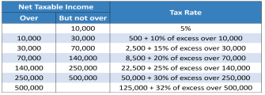
INCOME TAX RATES BEFORE TRAIN LAW

Slide 6
2025 TAX RATES
Income between PHP 0 and 250,000 is taxed at 0%.
Income between PHP 250,001 and 400,000 is taxed at 15%.
Income between PHP 400,001 and 800,000 is taxed at 20%.
Income between PHP 800,001 and 2,000,000 is taxed at 25%.
Income between PHP 2,000,001 and 8,000,000 is taxed at 30%.
Income above PHP 8,000,000 is taxed at 35%

Slide 7
THE VISION OF TRAIN LAW IS TO ACHIEVE THE FOLLOWING:
Poverty rate reduced from 26% to 17% (or some 10 million Filipinos uplifted from poverty).
Law-abiding country.
Peace within the country and with our neighbors.
Achieve high middle-income status, where per capital gross national income (GNI) increased from USD 3,000 to USD 4,200 by 2022 in today’s money.
Eradicate extreme poverty.
Inclusive economic and political institutions where everyone has equal opportunities.
Achieve high income status where per capital GNI increases from USD 3,000 to USD 12,000 by 2040 in today’s money.

Slide 8
The TRAIN law aims to fix problems in the current tax system by lowering and simplifying personal income taxes, simplifying estate and donor's taxes, broadening the VAT base, adjusting oil and car excise taxes, and adding a tax on sugary drinks.
TRAIN lowered personal income tax rates and introduced an optional 8% flat tax for individual taxpayers, leading to more savings and higher take-home pay. It also simplified estate and donor's taxes with a 6% flat rate and increased allowable deductions. The VAT threshold was raised from ₱1.92 million to ₱3 million, exempting more taxpayers. Additionally, TRAIN increased excise taxes on petroleum, minerals, and automobiles, and introduced a tax on sugary drinks.

Slide 9
CHANGES IN THE TAX SYSTEM UNDER THE TRAIN LAW

Slide 10
REDUCED TAXES
PERSONAL INCOME TAX
ESTATE TAX
DONORS TAX
VALUE ADDED TAX

Slide 11
PERSONAL INCOME TAX
The most popular part of the Train law is the reduction of personal income tax of a majority of individual taxpayers. Prior to the enactment of the new law, an individual employee or self-employed taxpayer would normally have to pay income tax at the rate of 5% to 32%, depending on one's bracket.

Slide 12
PERSONAL INCOME TAX
Under Train, an individual with a taxable income of P250,000 or less will now be exempt from income tax. Those with a taxable income of above P250,000 will be subject to the rate of 20% to 35% effective 2018, and 15% to 35% effective 2023.

Slide 13
PERSONAL INCOME TAX
Additionally, minimum-wage earners are still exempted from PIT. The Law also ensures a minimum wage earner who incurs a small raise will not have his overall salary (with the PIT deducted) less than minimum wage. Also, married couples where both parties are working may be exempted up to ₱500,000.

Slide 14
ESTATE TAX
The estate tax is now reduced to 6% based on the net value of the property. It also has a standard deduction of ₱5 million as well as a ₱10 million exemption on the family home.

Slide 15
DONORS TAX
The donor’s tax rate was also amended to a single rate of 6% regardless of the relationship between the donor and the donee. In the old law, the rates of donor’s tax were 2% to 15% if the donor and donee are related, and 30% if otherwise. However, the donation of real property is now subject to Documentary Stamp Tax of P15 for every P1,000.

Slide 16
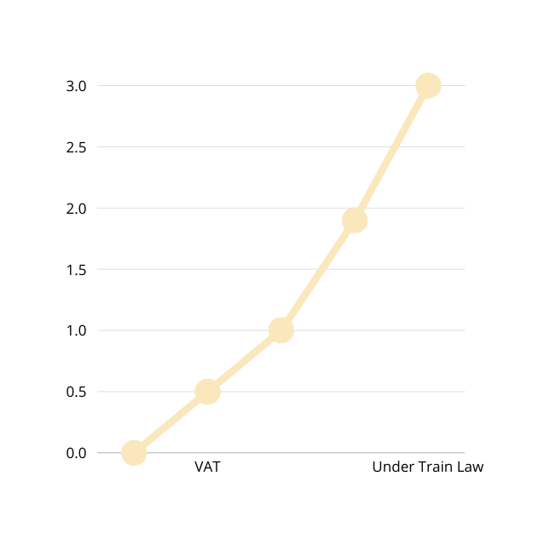
VALUE ADDED TAX (VAT)
VAT Threshold Increased:
From ₱1.9 million to ₱3 million in annual sales.
Small businesses earning ₱3M or less are exempt from VAT.

Slide 17

VALUE ADDED TAX (VAT)
Purpose of the Change:
To make VAT system simpler and fairer.
To reduce compliance costs for taxpayers and tax agencies.
To help small businesses grow and create more jobs.

Slide 18
VALUE ADDED TAX (VAT)
VAT Exemptions (starting 2019 onwards):
Medicines for:
Hypertension
High cholesterol
Diabetes
Purchases by:
Senior citizens
Persons with disabilities (PWDs)
VAT Exemption on Housing:
Starting 2021, houses costing less than ₱2 million are VAT-free.
Other VAT-Exempt Sectors:
Health
Education
Raw agriculture food

Slide 19
PASSIVE INCOME
Train imposes higher taxes on some passive incomes, including interest income from dollar and other foreign currency deposits.
There is also a significant increase in the tax on sale of shares of stocks.
PASSIVE INCOME. NIRC TRAIN
Interest from foreign currency deposit
7.5% 15%
Interest income from pre-terminated long term deposits
5–20% 20%
exempt
20% if more than ₱10,000
PCSO winnings

Slide 20
EXCISE TAX
Train imposes higher excise taxes on cigarettes, manufactured oils (petroleum products), mineral products and automobiles.
KINDS OF SHARES. NIRC TRAIN
Sale of shares of stocks not
traded through stock exchange
5–10% 15%
Sale of Shares of Stock Listed and Traded through the Local Stock Exchange
½ of 1%
6/10 of 1%

Slide 21
DOCUMENT STAMP TAX
Documentary Stamp Tax (DST) is a tax applied on the execution of documents such as deeds, instruments, loan agreements, and other transaction documents that evidence the acceptance, assignment, sale, or transfer of an obligation, right, or property incident thereto.

Slide 22
3. NEW TAXES
Aside from increase and decrease of certain taxes, Train also introduces new taxes in the form of excise tax on sweetened beverages and non-essential services.

Slide 23
SWEETENED BEVERAGES
The SSB (Sugar-Sweetened Beverages) tax will promote a healthier Philippines. It achieves this by reducing the increasing number of diabetes and obesity cases, through raising awareness, promoting the consumption of healthier products and encourage companies to innovate healthier alternatives.

Slide 24
SWEETENED BEVERAGES
Using purely caloric sweeteners, and purely non-caloric sweeteners, or a mix of the two sweeteners | Using purely caloric sweeteners, and purely non-caloric sweeteners, or a mix of the two sweeteners | ₱6.00 per liter
Using purely high fructose corn syrup or in combination with any caloric or non-caloric sweetener | Using purely high fructose corn syrup or in combination with any caloric or non-caloric sweetener | ₱12.00 per liter
TRAIN imposes new taxes of ₱6 per liter on drinks containing sweeteners and ₱12 per liter on drinks containing high-fructose corn syrup. Milk, 100% natural juice, and 3-in-1 instant coffee drinks are exempt from the excise tax.

Slide 25
NON-ESSENTIAL SERVICES
Invasive cosmetic procedures directed solely towards improving, altering, or enhancing the patient's appearance is now subject to excise tax of 5%.
PCSO WINNINGS
Previously, PCSO winnings, regardless of amount, were exempt from tax. Train subjects PCSO winnings to a 20% final withholding tax if the amount is more than P10,000.

Slide 26
PROS AND CONS OF TRAIN
Advocates and opponents of TRAIN point out the folloWING POTential benefits and negative impacts of the program:

Slide 27
POTENTIAL BENEFITS

Slide 28
POTENTIAL BENEFITS
1. higher take home pay and and therefore improved spending power, particularly for those earning P40 000 a month or less.
2. better income rate after taxes for corporations.

Slide 29
POTENTIAL BENEFITS
3. more efficient tax collection.
4. offsetting measures said to affect the most affluent businesses and individual will generate income that will be used in the goverment's aggresive infrastructure projects and in improving basic services such as housing, education and social protection.

Slide 30
POTENTIAL NEGATIVE IMPACT

Slide 31
1. Inflationary effects of higher petroleum prices that are seen to mostly affect the bottom 60% of households. The government aims to offset these effects with a "transfer scheme" that will allocate around P30 billion from petroleum excise taxes to support the bottom sectors. This scheme has been criticized, however, for being unsustainable projected to last only one to four years and a "logistical nightmare."
2. Excise taxes on sugar-sweetened drinks will burden the bottom sectors, particularly those who are already tax exempt under the current taxation system, and therefore will not benefit from the lowered tax rates

Slide 32
3. Higher property taxes due to higher property valuation
4. Investors who are looking to benefit from PEZA (Philippine Economic Zone Authority) incentives may be discouraged by the removal or restructuring of some of these incentives
5. VAT on low-rental housing may lead to higher rental costs
6. For small businesses like sari-sari stores, being taxed on gross income rather than net income (computed after expenses) can mean higher tax payments

Slide 33
What is Train Law and its purpose?
What are the changes in the tax system under the Train Law?
What are the advantages and disadvantages of Train Law to economy?
How will the Train Law affect individuals in different income classification?
Notes:
1. The TRAIN Law stands for Tax Reform for Acceleration and Inclusion
Make the tax system fairer and simpler
Lower income tax for most Filipinos
Raise government revenue to fund infrastructure and social services (like the Build, Build, Build program)
2. What are the changes in the tax system under TRAIN Law?
Lowered personal income taxes for most salaried workers
✅ Increased excise taxes on:
Fuel/petroleum products
Automobiles
Sugar-sweetened beverages
Cigarettes and other "sin" products
✅ Reduced VAT exemptions (made VAT more focused and broad-based)
✅ Higher Documentary Stamp Tax (DST) on financial documents
3. What are the advantages and disadvantages of TRAIN Law to the economy?
Advantages:
More take-home pay for low and middle-income earners
Boosts consumer spending
Funds major government projects and infrastructure
Promotes a progressive tax system
Disadvantages:
Higher prices of goods (due to fuel and excise taxes)
Inflation spikes, especially right after implementation
Can hurt low-income families if prices rise faster than benefits
Public transport fares and delivery costs also increased
4. How does TRAIN Law affect people in different income classes?
Low-Income (below ₱250,000 annually)
✅ Zero personal income tax
❌ But feel the pinch from rising prices (fuel, goods, fares)
🧑‍💼 Middle-Income
✅ Big relief in income tax = more take-home pay
❌ Might still feel inflation in transport, groceries, etc.
🕴️ High-Income (above ₱8 million/year)
❌ Higher income tax (35%)
❌ Pay more for cars, luxury items, premium fuels

Slide 34
THANK YOU

